Slide 1
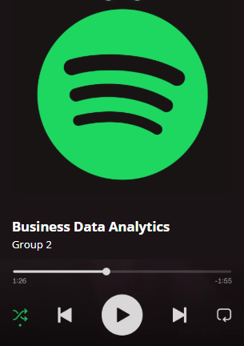

SPOTIFY SONG POPULARITY PREDICTION AND RECOMMENDATION OPTIMIZATION
INFO 648 – BUSINESS DATA ANALYTICS
Group 2:
Aakash Kathirvel
Chandhini Kerachan Muraleedharan
Matt Ferguson
Milan Chaudhari

Slide 2

Introduction and Objectives
Client: Spotify Music Streaming Service
Goal: Improve recommendation system by predicting songs likely to become popular at the time of release.
Dataset: songs_utf.csv
Mainfocus:
Predicting whether a song will be popular
Maximize monetary value based on prediction outcomes
Understand how song characteristics like valence and genre impact success
Qn 1: Predict if a songs popularity score exceeds 64
Qn 2: Select model based on profit ( not just the accuracy) considering spotify’s revenues and costs.
Qn 3: Analyze how valence and genre affect song success and identify feature patterns to improve playlist recommendations

Slide 3

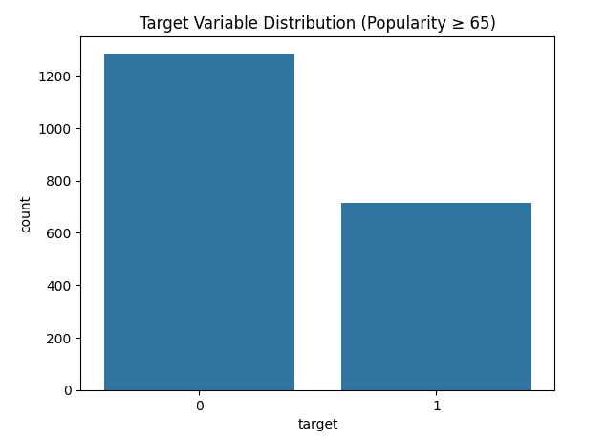
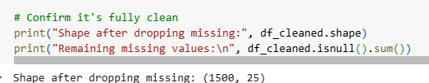
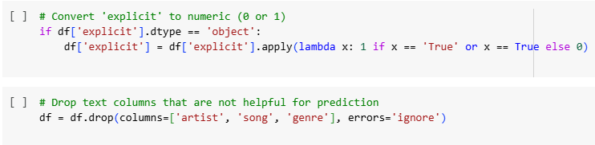
Question 1. Feature Selection and
Data Preprocessing
Data Loading and Cleaning
Imported Spotify dataset (songs_utf.csv) from Google Drive.
Previewed initial rows, checked structure and missing values.
Converted explicit feature to numeric (0 = No, 1 = Yes).
Dropped irrelevant text columns: artist, song, genre.
Final dataset: 1,500 songs × 25 features (fully cleaned).
Target Variable Creation
Created a new binary target:
  1 if popularity ≥ 65 (popular),
  0 otherwise (non-popular).
Verified target distribution: with Bar Chart

Slide 4
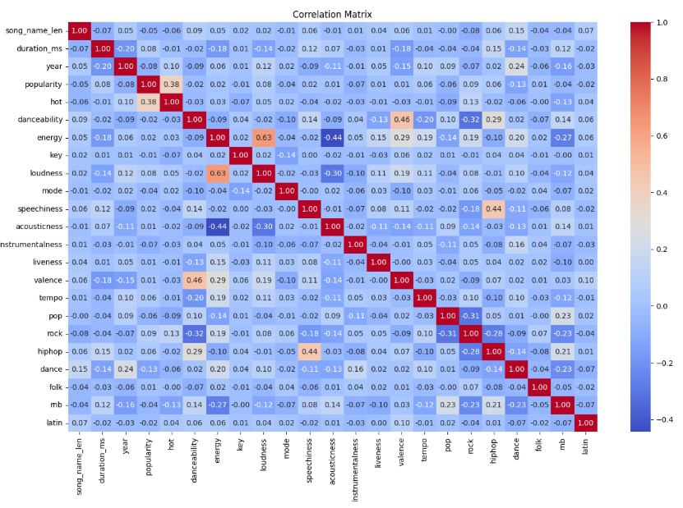
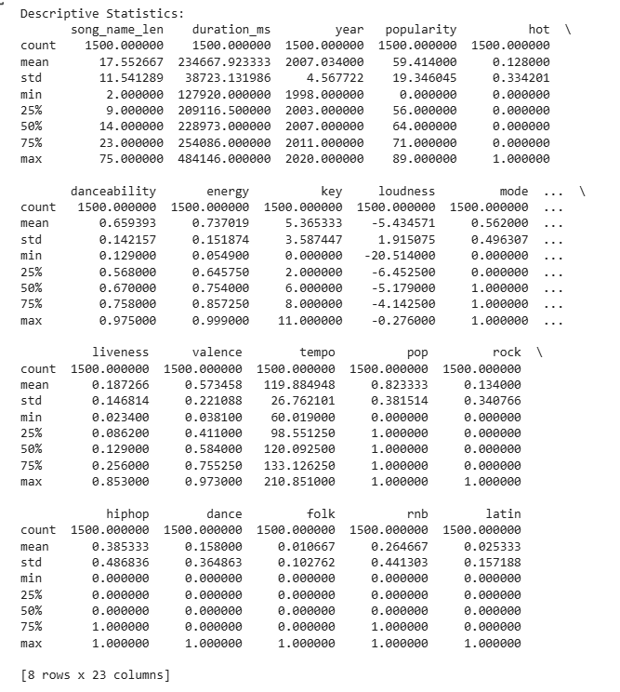

Exploratory Data Analysis and Data Preparation
Exploratory Analysis
Generated descriptive statistics (mean, median, range) for numerical features.
Plotted a correlation matrix to study feature relationships:
No strong multicollinearity found.
Final Preparation
Saved cleaned dataset to new CSV file for modeling.
Dataset fully ready for model training and evaluation.
Key Takeaway
Careful preprocessing ensured high-quality, consistent, and relevant input for predictive modeling.

Slide 5
Question 1. Introduction
Objective:
Predict whether a song's popularity score exceeds 64 (i.e., popularity >= 65) based on song features.
Dataset:
Spotify song attributes like danceability, tempo, loudness, speechiness.
Target Variable:
Binary classification → Popular (1) vs Not Popular (0).
Approach:
1. Develop and compare three models:
KNN, Decision Tree, Logistic Regression.
2. Choose the best model based on accuracy and cross-validation if needed.
3. Provide managerial insights for promoting more engaging songs.

Slide 6
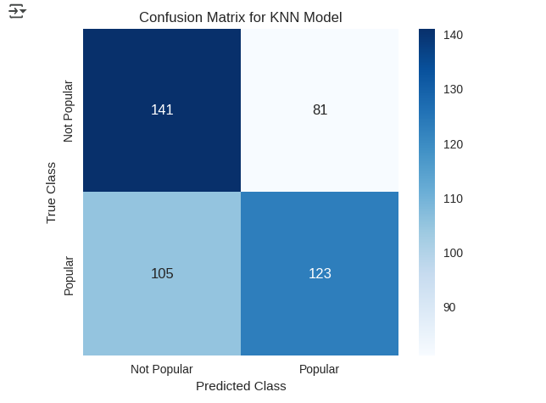
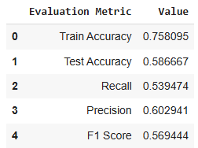
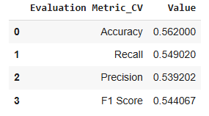
KNN Classifier - Results
Method: K-Nearest Neighbors (KNN) Classifier
Standardized features.
Explored different K values for optimal performance.
Performance
Holdout/Test Accuracy: (KNN accuracy, 75.8% training, 58.6% test)
Cross-Validation Accuracy: (similar to test accuracy but slightly lower at 56.2% test accuracy)
KNN Hyperparameter Accuracy: (no significant difference with test accuracy at 57.8%)
Insights
KNN struggled to identify the variance needed to classify songs as popular. Model reliance on comparing similarities makes it sensitive to noise, normalizing features, and class imbalance.
For complex, multi-factor datasets like this, KNN was not the best modeling approach.

Slide 7
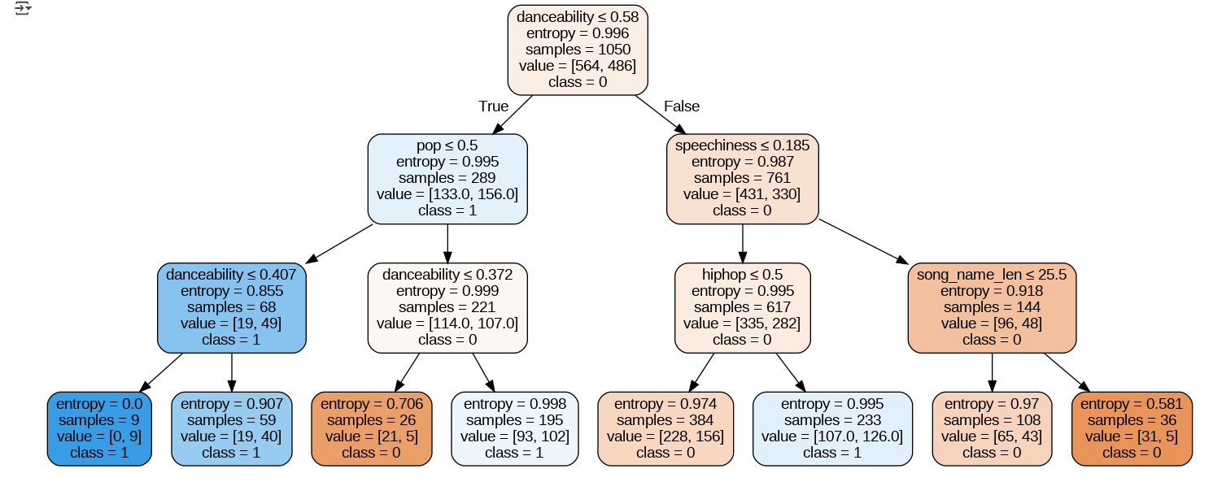
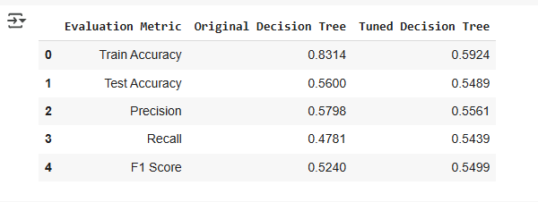
Decision Tree Classifier Results
Method: Decision Tree Classifier.
Steps:
Built initial tree, pruned using GridSearchCV (tuned max_depth, min_samples_split).
Performance:
Holdout/Test Accuracy: 56%
Cross-Validation Accuracy: 52.1%
Fine-Tuned Accuracy: 54.9%
Insights:
Easy interpretation, but model performance was not robust.
High overfitting risk due to overlapping features (danceability), shown by the large gap between training and test performance.

Slide 8
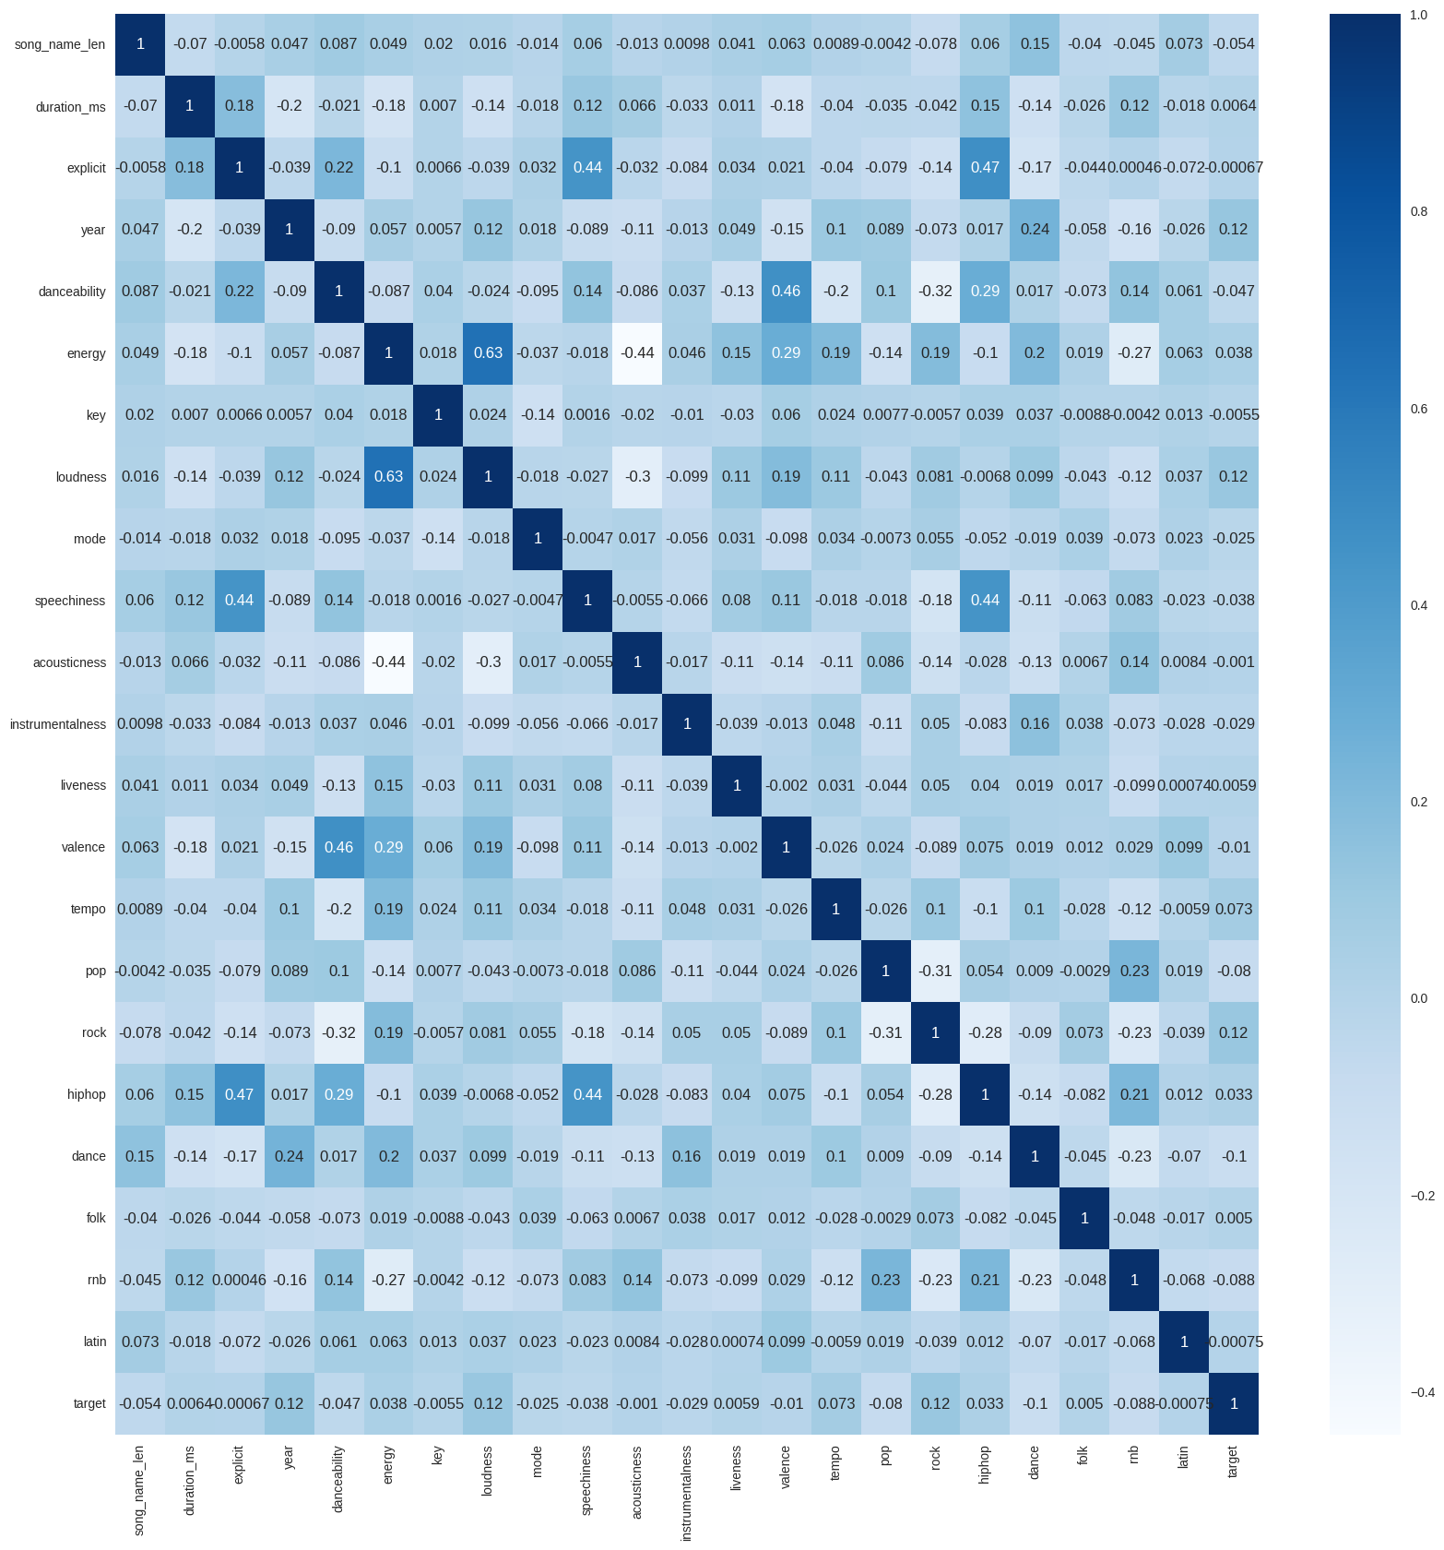
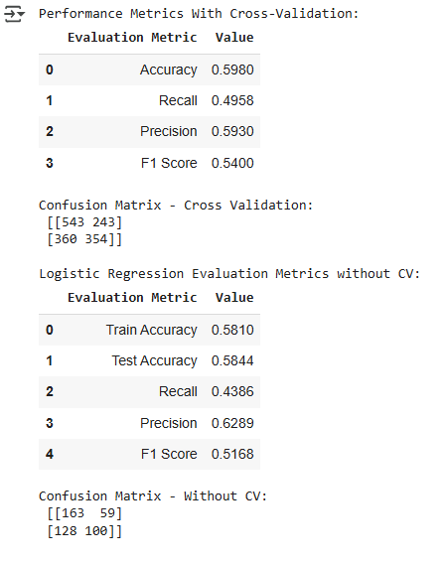
Logistic Regression - Results
Method: Logistic Regression Classifier.
Steps:
Selected features after removing multicollinearity using VIF.
Standardized features.
10-Fold Cross-Validation performed.
Performance:
Holdout/Test Accuracy: 58%-59%
Cross-Validation Accuracy: ~59.8%
Precision: ~59%, F1 Score: ~54%
Insights:
Good balance between precision and recall.
Model generalizes well compared to kNN, and Decision Tree with overfitting issues.

Slide 9
Comparison and Final Conclusion
Model Comparison:
KNN: Moderate accuracy (~58%), sensitive to noisy features.
Decision Tree: Overfit, poor generalization (Test Accuracy ~56%).
Logistic Regression: Best generalization (Test Accuracy ~58%-59%), stable across folds.
Final Choice:
Logistic Regression selected because:
It achieved highest cross-validation accuracy (59.8%).
More stable and interpretable.
Less sensitive to noise compared to KNN and Decision Trees.
Managerial Insights:
Focus on promoting songs with higher danceability, tempo, energy, and loudness.
These features have positive association with higher popularity (based on Logistic Regression odds ratios).

Slide 10
Question 2. Cost Benefit Analysis
Revenue for Correct Prediction (Popular Song): +$1,000
Cost for False Positive (Non-Popular predicted as Popular): –$700
Cost for False Negative (Popular predicted as Non-Popular): –$900
No cost or revenue for correctly predicting a non-popular song.

Slide 11
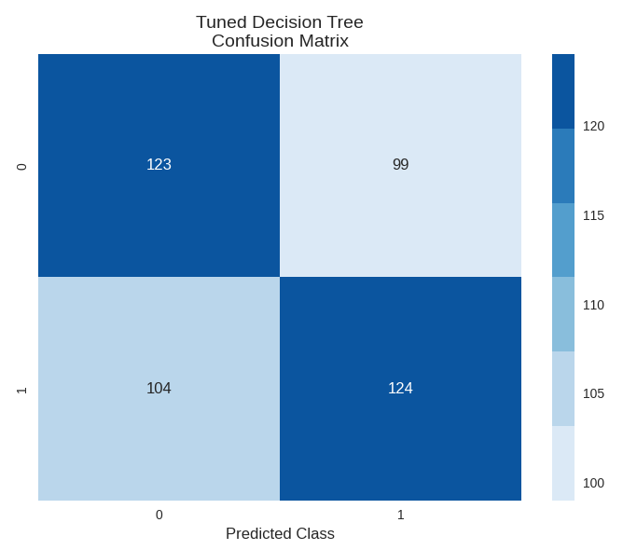
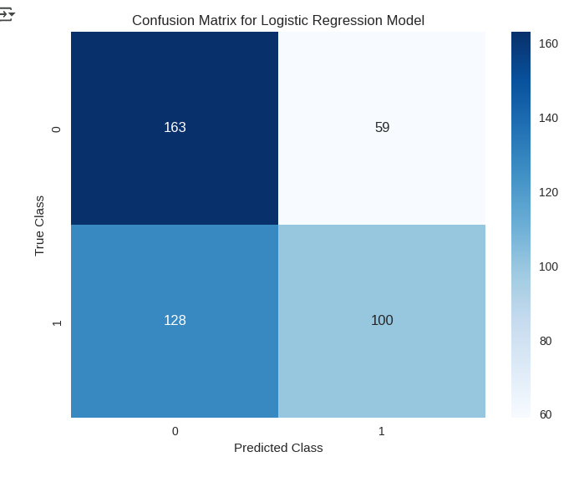
Question 2. Revenue Cost Structure
KNN
From the confusion matrix:
TP = 123, FP = 81, FN = 105, TN = 141
Total Value = (123 × 1000) + (81 × -700) + (105 ×-900) = 123,000 – 56,700 – 94,500
= –$28,200
Decision Tree
From the confusion matrix:
TP = 124, FP = 99, FN = 104, TN = 123
Total Value = (124 × 1000) + (99 × -700) + (104 × -900) = 124,000 – 69,300 – 93,600 = –$38,900
Logistic Regression
From the confusion matrix:
TP = 100, FP = 59, FN = 128, TN = 163
Total Value = (100 × 1000) + (59 × -700) + (123 × -900) = 100,000 – 41,300 – 1,10,700 = –$52,000

Slide 12
Question 3. Introduction – Problem Statement
Objective:
Understanding the impact of a song’s valence (musical positivity) on its success across different types of music.
Identifying features or combinations of features frequently associated with high or low popularity to improve playlist recommendations.
Dataset:
Spotify song attributes including danceability, energy, genre indicators (pop, rock, hiphop, dance, folk, rnb, latin), valence, and more.
Target Variable:
Binary classification → Popular (1) vs Not Popular (0) based on a popularity score ≥ 65.
Approach:
Applying K-Means Clustering using danceability, energy, and optional genre attributes.
For each cluster, analyze characteristics and model the impact of valence on success using Logistic Regression.
Identifying features linked to higher or lower popularity.
Providing insights to enhance playlist recommendations based on feature patterns.

Slide 13
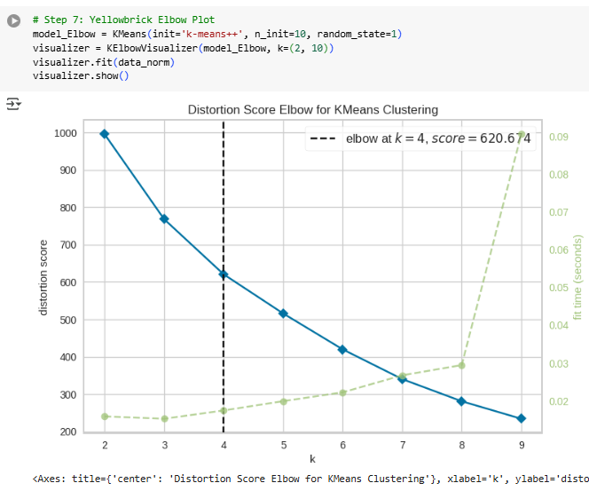
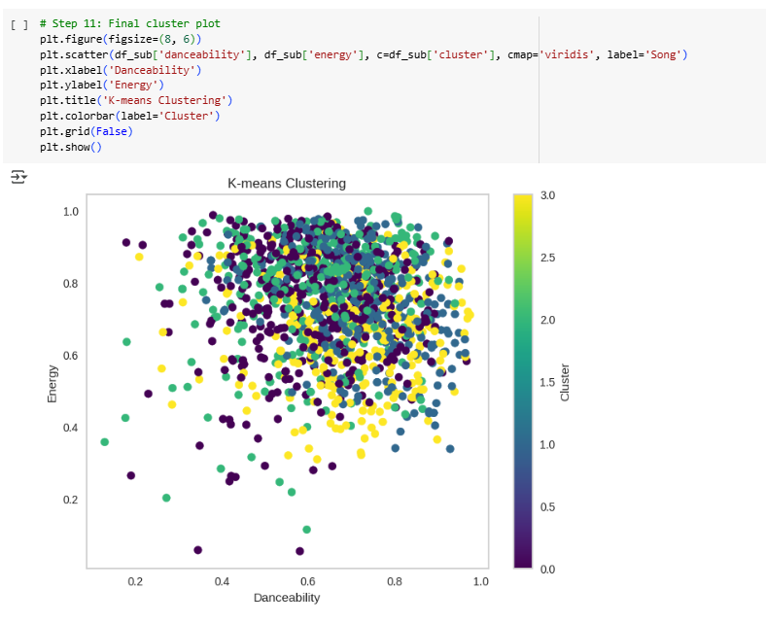
K Means Clustering and Valence Impact Analysis
Features Selected: Danceability, Energy, Pop, Rock, Hiphop, Dance, Folk, RnB, Latin.
Normalized data using MinMaxScaler.
Applied K-Means clustering, optimal k=4 chosen using Elbow Method.
Clusters Analysis:
  Songs grouped into four distinct clusters with varying danceability and energy.
Valence Analysis:
  Songs grouped into four distinct clusters with varying danceability and energy.
Feature Importance:
  Popular songs have higher energy, tempo, loudness, and positivity.

Slide 14
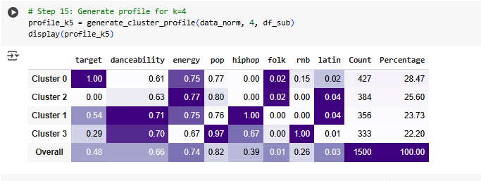
Key Insights from Clustering Analysis
Clusters show that song success patterns differ based on musical characteristics.
Valence has a stronger positive impact in clusters with high danceability and energy.
Features like loudness, tempo, and energy are strongly associated with popularity.
Recommendations for Spotify:
Promote songs with high energy, positive valence for general playlists.
Customize playlists based on cluster profiles for different audience preferences.

Slide 15
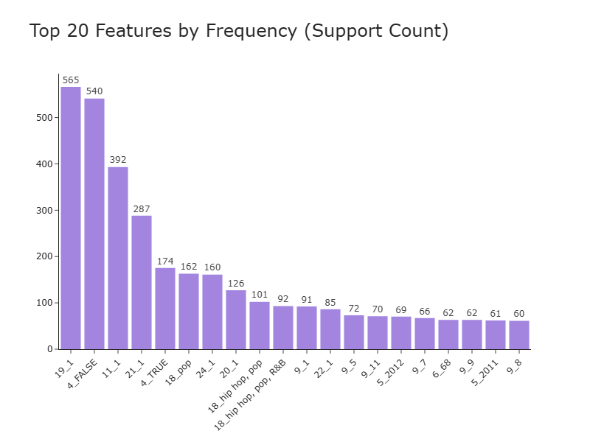
Feature Appearance – Association Rule
Popular Songs (popularity ≥ 65):
Pop Genre (19_1)
Clean Lyrics (4_FALSE)
Major Mode (Happy Sound) (11_1)
Genre Blending: Pop + Hip Hop + Latin
Artist Examples: Coldplay (Rock-Pop), David Guetta (Pop-Dance)
Unpopular Songs (popularity ≤ 20):
Pop Genre still common, but with failure
Clean Lyrics present but insufficient
Major Mode songs can also flop
Isolated Dance/Electronic genre without strong branding

Slide 16
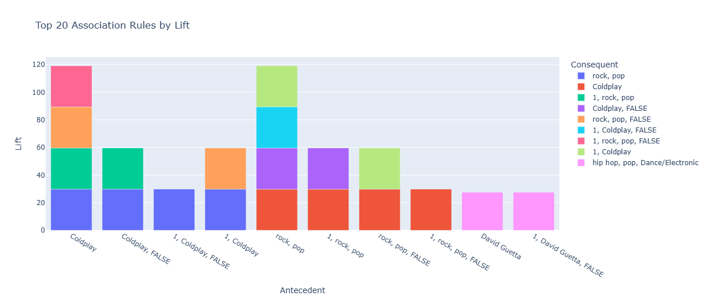
Suggestion to Improve Recommendation Playlist
Coldplay → Rock + Pop + Clean lyrics
David Guetta → Pop + Hip Hop + Dance/Electronic
Coldplay's songs are closely associated with rock + pop genres and clean (non-explicit) content.
Songs labeled as rock + pop can be reliably recommended to Coldplay fans — their listening taste heavily matches that style.
David Guetta's music is linked more to hip hop, pop, and dance/electronic — a different cluster appealing to dance fans.
Association analysis shows that Coldplay songs strongly cluster around rock-pop genres with clean lyrics, while David Guetta's tracks blend pop, hip hop, and dance/electronic elements — guiding genre-focused and artist-personalized recommendations.

Slide 17

Strategic Recommendations for Spotify:
Use Logistic Regression for clean, interpretable popularity prediction.
→ Focus on features like clean lyrics, major key, and genre blending.
Apply KNN when profit is the priority.
→ Balances true hits with cost of misclassification.
Curate playlists by mood and energy clusters.
→ High valence + high energy songs are more popular.
Promote genre-blended tracks and artist–genre combos.
→ Examples: Pop + Hip Hop + Latin (David Guetta), Rock + Pop (Coldplay).
Prioritize clean, upbeat, multi-genre songs.
→ Broader reach and higher success rate.
Business Impact
Data-driven recommendations can increase user engagement, improve playlist quality, and maximize streaming revenue.
Combining predictive modeling with association insights enables smarter, customized playlist strategies.

Slide 18

Thank You

